Slide 1
Outcomes and action plans from the Pathophysiology and Pathways of Preterm Birth Working Group

Slide 2
Participants
Michael Taggart (facilitator)
Emmeli Mikkelsen (facilitator)
Emmanuel Amabebe
Deena Gibbons
Oksana Synlova
Sam Mesiano
Andrea Olmos-Ortiz
Emily Hamburg-Shields
Egle Prewit

Slide 3
Emergent concepts and evidence
Characterization of resident uteroplacental immune cells (parturition as an inflammatory event).
Paracrine mediators of signaling and parturition (myometrial, decidual, placental, fetal membranes).
Role of vaginal microbiome and its mechanistic relation to PTB.
Circulating cellular materials (e.g. EVs, cfDNA, fetal cells).
Other biomarkers (by understanding a biomarker gives you an insight into the pathophysiologic processes).
Notes:
… in understanding the pathophysiology of PTB this century.

Slide 4
Further attention
What mechanisms lead to normal parturition?
Classification of phenotypes/pathways of PTB:
  Pathology
  Physiology
Life-course health implications for mother and baby.
Notes:
In order to better inform mechanisms in PTB, we need to understand the normal physiology of parturition.
Does preterm birth have each own pathology or is it the same physiology as in term birth just happening premature? Pathology: Infection. Physiology: Overwhelmed/overstimulated (too high amount of stress), sterile hyper-inflammation.
There are different pathways for PTB, which have different pathologies. Therefore, it is very difficult to find a common biomarker or biomarkers for PTB.

Slide 5
Next horizons
Mathematical modelling (single cell to whole organ mechanisms).
Machine learning (Artificially Intelligence).
Clarity of patient phenotypes to avoid heterogenous samples:
  Longitudinal studies
  Multicenter studies
Notes:
Biomarkers to imaging methods. Mathematical modelling is a quantitative framework for using different methods to generate hypotheses and testing them.
Machine learning can assist with the analysis of digitized patient data.
Longitudinal studies: The real phenotype of PTB can be missed in cross-sectional studies.
Multicenter studies to get enough power, as PTB is a rare event and the different phenotypes are even rarer.

Slide 6
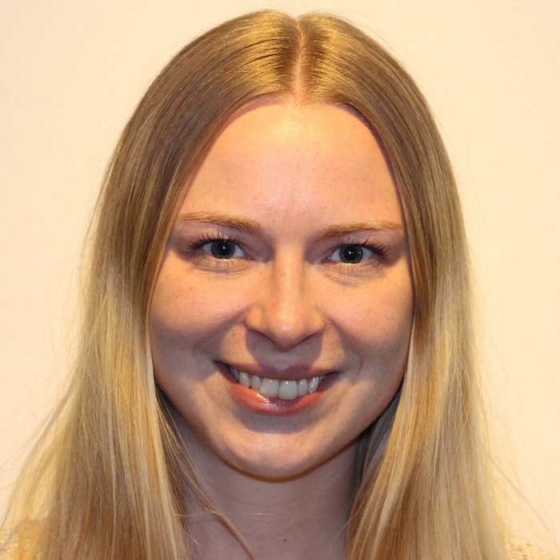

Key output
Emmeli F. R. Mikkelsen
emmeli.mikkelsen@clin.au.dk
Paper on emergent concepts and evidence on the pathophysiology in parturition and spontaneous preterm birth incl. next horizons.

