Slide 1

Clinical Intervention and Commercialisation
Natasha Singh (facilitator)
Dilly Anumba (facilitator)
Jarek Kalinka
Mariusz Grzesiak
Louisa Seopela
Hannah Rosen O’Sullivan
Shiru Mariam Motunrayo
Hadijat Raji
Shady Saleem
Croatia 2023

Slide 2
Identification of Gaps in clinical care
Global variation in data collection based on definition of viability
Hospital records not readily available in second pregnancy
Challenges with accuracy of dating of pregnancy
Limited resources
Lack preterm birth prevention service in some countries
UK
Poland
Egypt
Nigeria
South Africa

Slide 3
Post birth debrief service
Interview woman post preterm birth
Timing – immediate, 6 weeks postnatal
Inclusion criteria - gestational age – dependent on site
Identify risk factors
Data collection
Phenotype preterm birth on an individual basis
Plan for second pregnancy
Identify at individual level facilitators and barriers to prediction, prevention and preparation
Local benefit to women
Research rich observational data

Slide 4
Data collection
Discrete individual risk factors (age, BMI, ethnicity, previous pregnancy history etc)
Domestic violence, infection etc
Clinical symptoms in pregnancy
Birth outcomes

Slide 5
Timelines
Group meet every 3 months
Review progress
Review database – expert consenus on phenotyping of PTL
Draft and submission of white paper

Slide 6
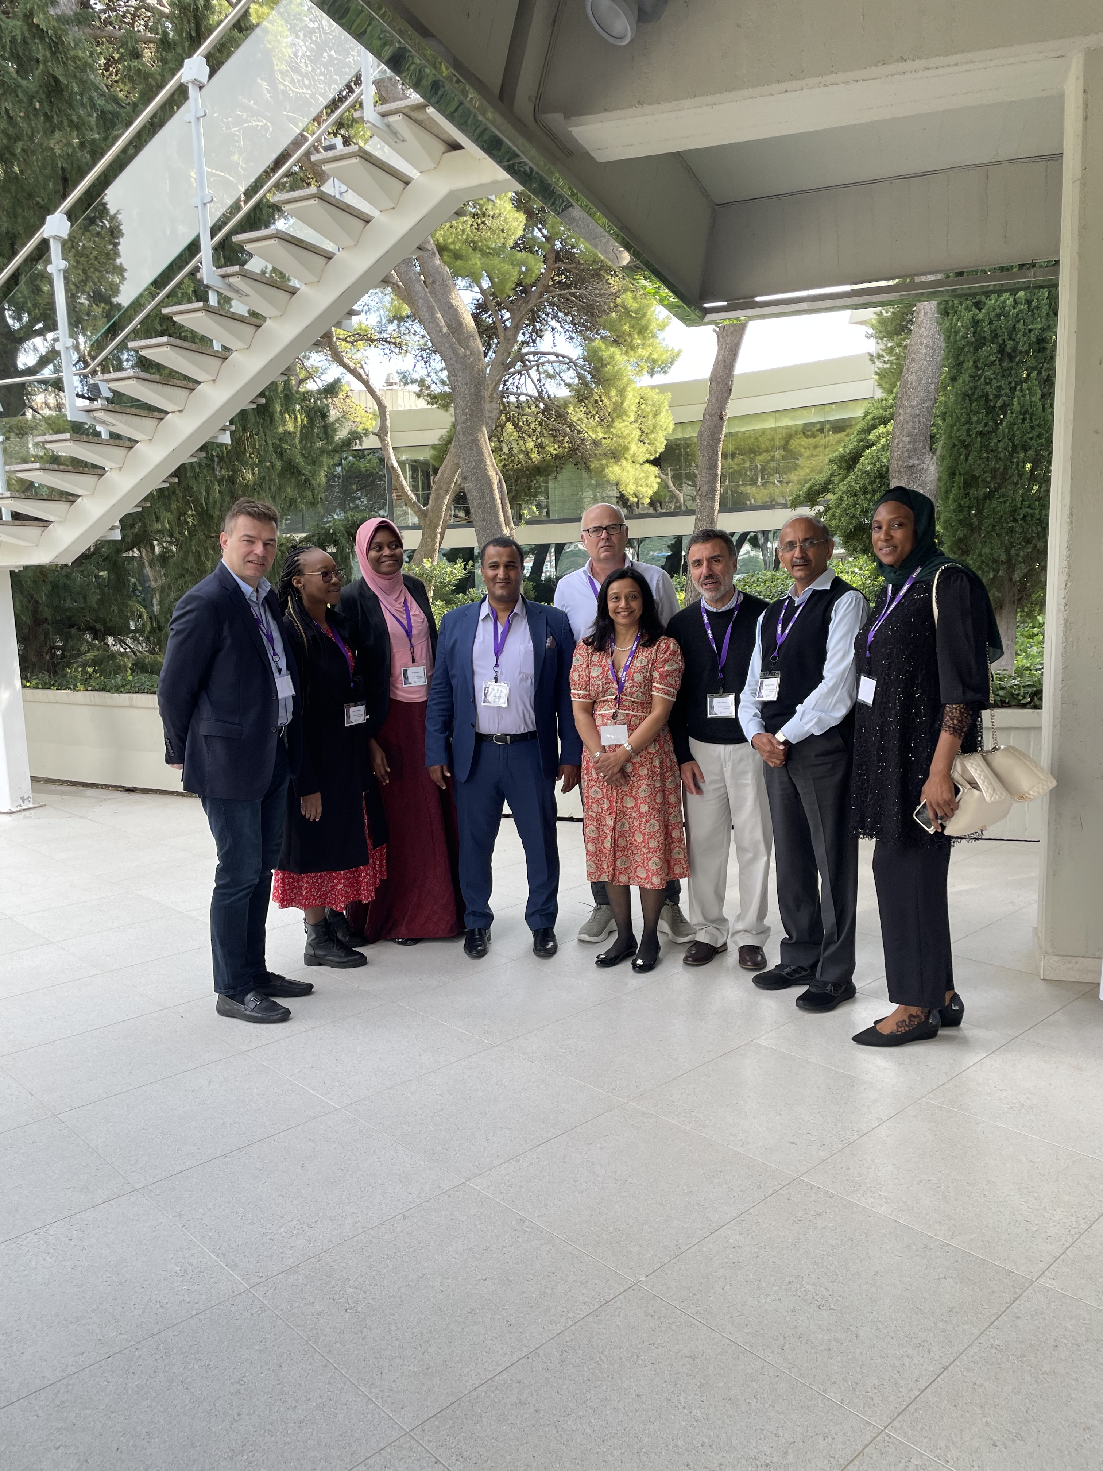

Thank you

