Slide 1
PREBIC NA 2022
Dr. Egle Prewit
Dr. Liping Feng
Dr. Stefanie Hinkle
Dr. Manuel Vidal
Pregnancy complicated by obesity
PFAS exposures and pregnancy complications and fetal development
Nutritional epidemiology and birth outcomes
Endocrine disruptors
Notes:
I am Manuel, MD, PhD

Slide 2
NUTRITION
ENVIRONMENT
PRETERM
BIRTH

Slide 3
NUTRITION, ENVIRONMENT, and PRETERM BIRTH
TOPICS TOUCHED ON
Obesity and pregnancy outcomes
Disparities in nutritional status
Food insecurity
Interactions of nutrition and environmental exposure
Databases for nutritional data NHANES
Databases for chemical exposures NICHD NIH
PFAS and bisphenols

Slide 4
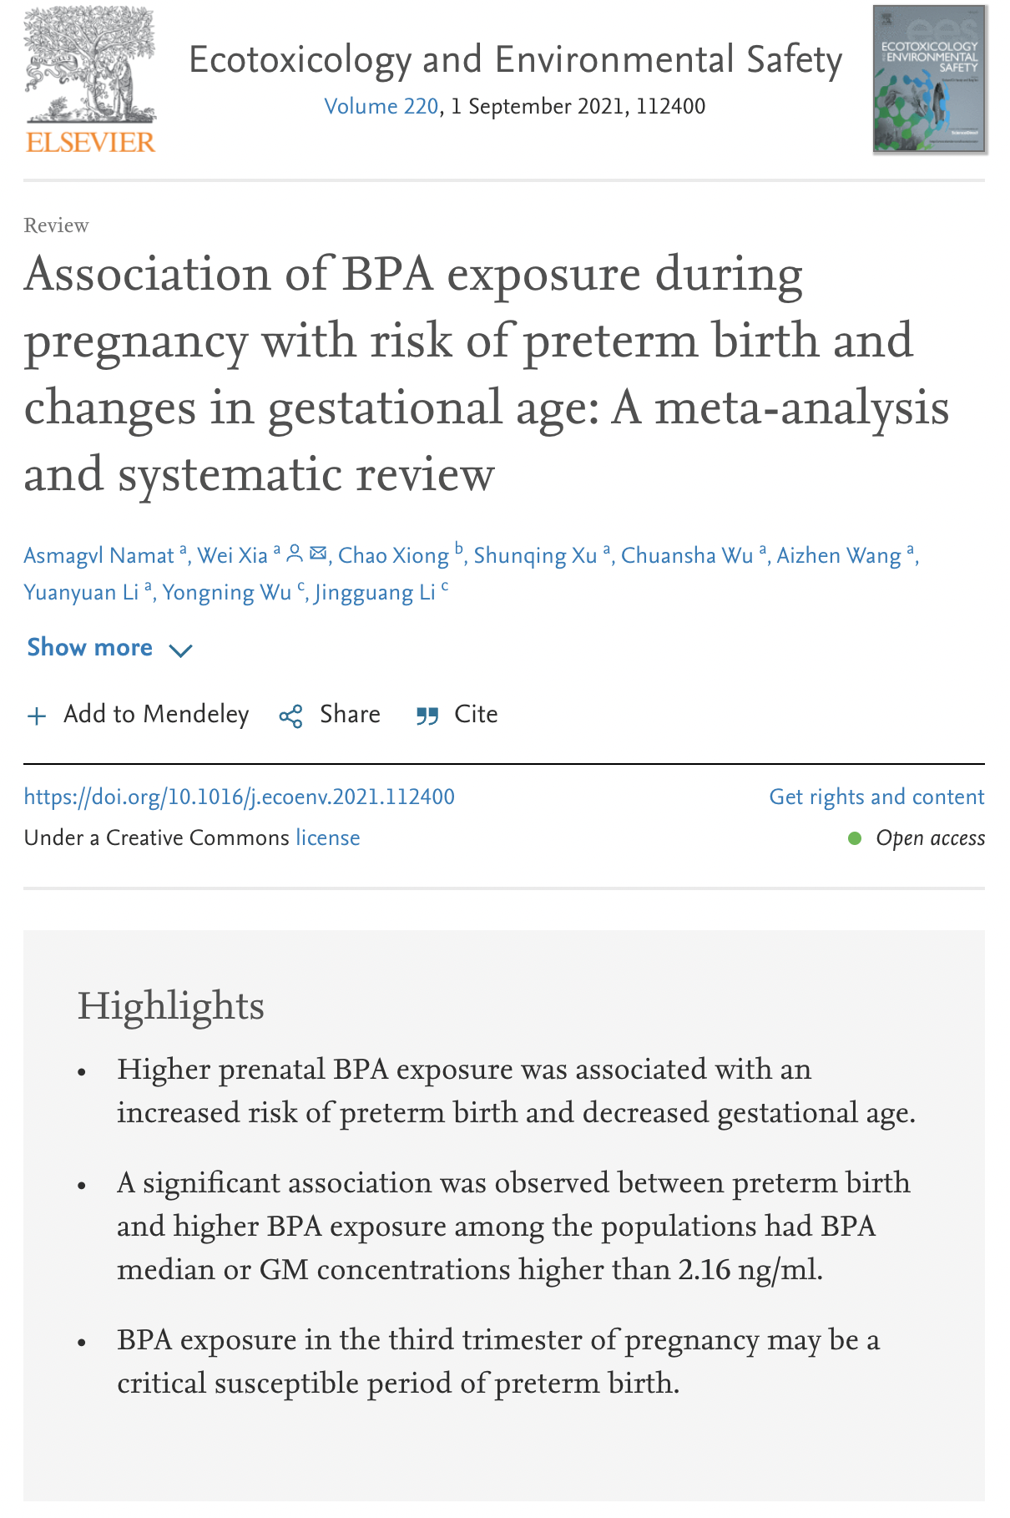

Slide 5
NUTRITION, ENVIRONMENT, and PRETERM BIRTH
FOCUSED ON
Literature search for bisphenols and preterm birth “Bisphenol-S and ("preterm birth" or "preterm delivery" or "gestational age")” 18 papers

Slide 6
Title | Authors | Notes
Prenatal exposure to bisphenols and risk of preterm birth: Findings from Guangxi Zhuang birth cohort in China | Liang, Ecotoxicol Environ Saf, 2021 | Bisphenol mixtures were related to an increased risk of PTB (OR = 1.52, 95% CI: 1.04, 2.21), with BPF (43.7%), BPS (29.6%) and BPA (26.8%) having the greatest positive contribution.
Urinary Concentrations of Bisphenol Mixtures during Pregnancy and Birth Outcomes: The MAKE Study | Kim, Int J Environ Res Public Health, 2021 | BPS was negatively associated gestational age (β = −0.09, 95% CI: −0.30 to 0.13, p-value = 0.43);
Prenatal urinary concentrations of phenols and risk of preterm birth: exploring windows of vulnerability | Zhang, Fertil Steril, 2021 | First trimester urinary bisphenol S concentrations showed a suggested risk of preterm birth (RR 1.25; 95%CI: 0.82, 1.89), although the small case numbers precluded sex-specific examination.
Maternal bisphenol urine concentrations, fetal growth and adverse birth outcomes: A population-based prospective cohort | Sol Environ Health, 2021 | Generation R. N=1379. Early, mid, and late pregnancy. Early = 1.63 (0.84, 3.24); Mid= 0.89 (0.43, 1.84); Late= N/A
Sex-specific associations of prenatal exposure to bisphenol A and its alternatives with fetal growth parameters and gestational age | Yang, Environ Int, 2021 | N=1197. the estimated mean decrease in gestational age for the highest vs. lowest exposure group of maternal urinary BPS in girls was 0.44 weeks (95% CI: −0.69, −0.20) (p for trend < 0.01)
Maternal and paternal preconception exposure to phenols and preterm birth | Mustieles, Environ Int, 2020 | RR for PTB 3.33 (1.13, 8.80)
Interactions between chemicals and non-chemical stressors: The modifying effect of life events on the association between triclocarban, phenols and parabens with gestational length in a Puerto Rican cohort | Aker, Sci Total Environ, 2020 | N = 752. Among women with negative total life events scores, BPS and triclocarban were associated with a 3-5 day decrease in gestational length [(−3.15; 95% CI:−6.06, −0.24); (−4.68; 95% CI: −8.47, −0.89)]
Bisphenol A and bisphenol S exposures during pregnancy and gestational age - A longitudinal study in China | Huang, Chemosphere, 2019 | Positive association of third-trimester BPS with gestational age was found
Preterm birth in relation to the bisphenol A replacement, bisphenol S, and other phenols and parabens | Aung, Environ Res, 2019 | Bisphenol-S detection at visit 4 was associated with overall preterm birth (adjusted odds ratio [95% CI]: 2.05 [1.09, 3.89]).
Maternal and paternal preconception exposure to bisphenols and size at birth | Mustiele, Hum Reprod, 2018 | No consistent patterns emerged for BPS concentrations measured in either parent.
Relationship between maternal exposure to bisphenol S and pregnancy duration | Wan, Environ Pollut, 2018 | One ln-unit increase in urinary BPS was associated with a 0.72-day increase in pregnancy duration (95% CI: 0.34, 1.09). When stratified by fetal sex, each ln-unit increase in maternal urinary BPS was significantly correlated with increased gestational age [adjusted β = 1.02, 95% confidence intervals (CI): 0.47, 1.57] and increased odds of late term birth [adjusted odds ratio = 1.29, 95% CI: 1.00, 1.67] for girls, but not significantly for boys.

Slide 7
NUTRITION, ENVIRONMENT, and PRETERM BIRTH
FINAL ACTION
Very limited studies on BPS health effects as an alternative to BPA
Check for associations of maternal exposures of BPS and preterm birth

