Slide 1

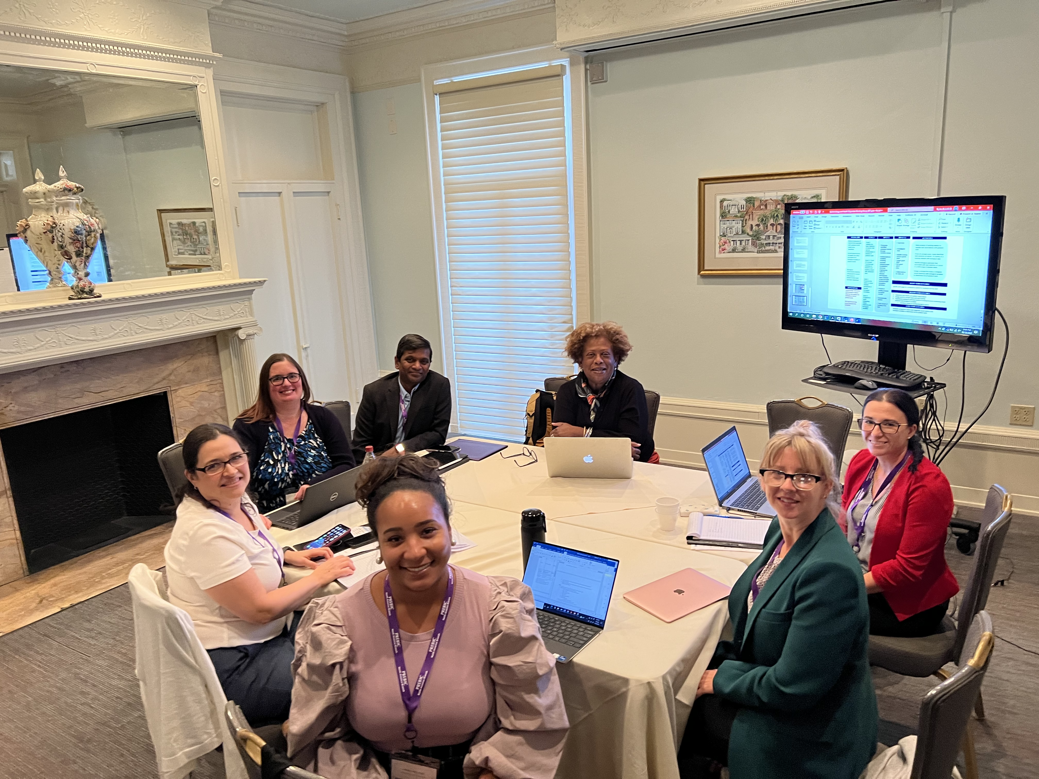
Epidemiology and Health Disparities Working Group
Brandie DePaoli Taylor
Scott Williams
Elizabeth Bonney
Ashley Hill
Maria Perez-Patron
Claire Kendal-Wright
Nagendra Monangi
Kelli Ryckman

Slide 2
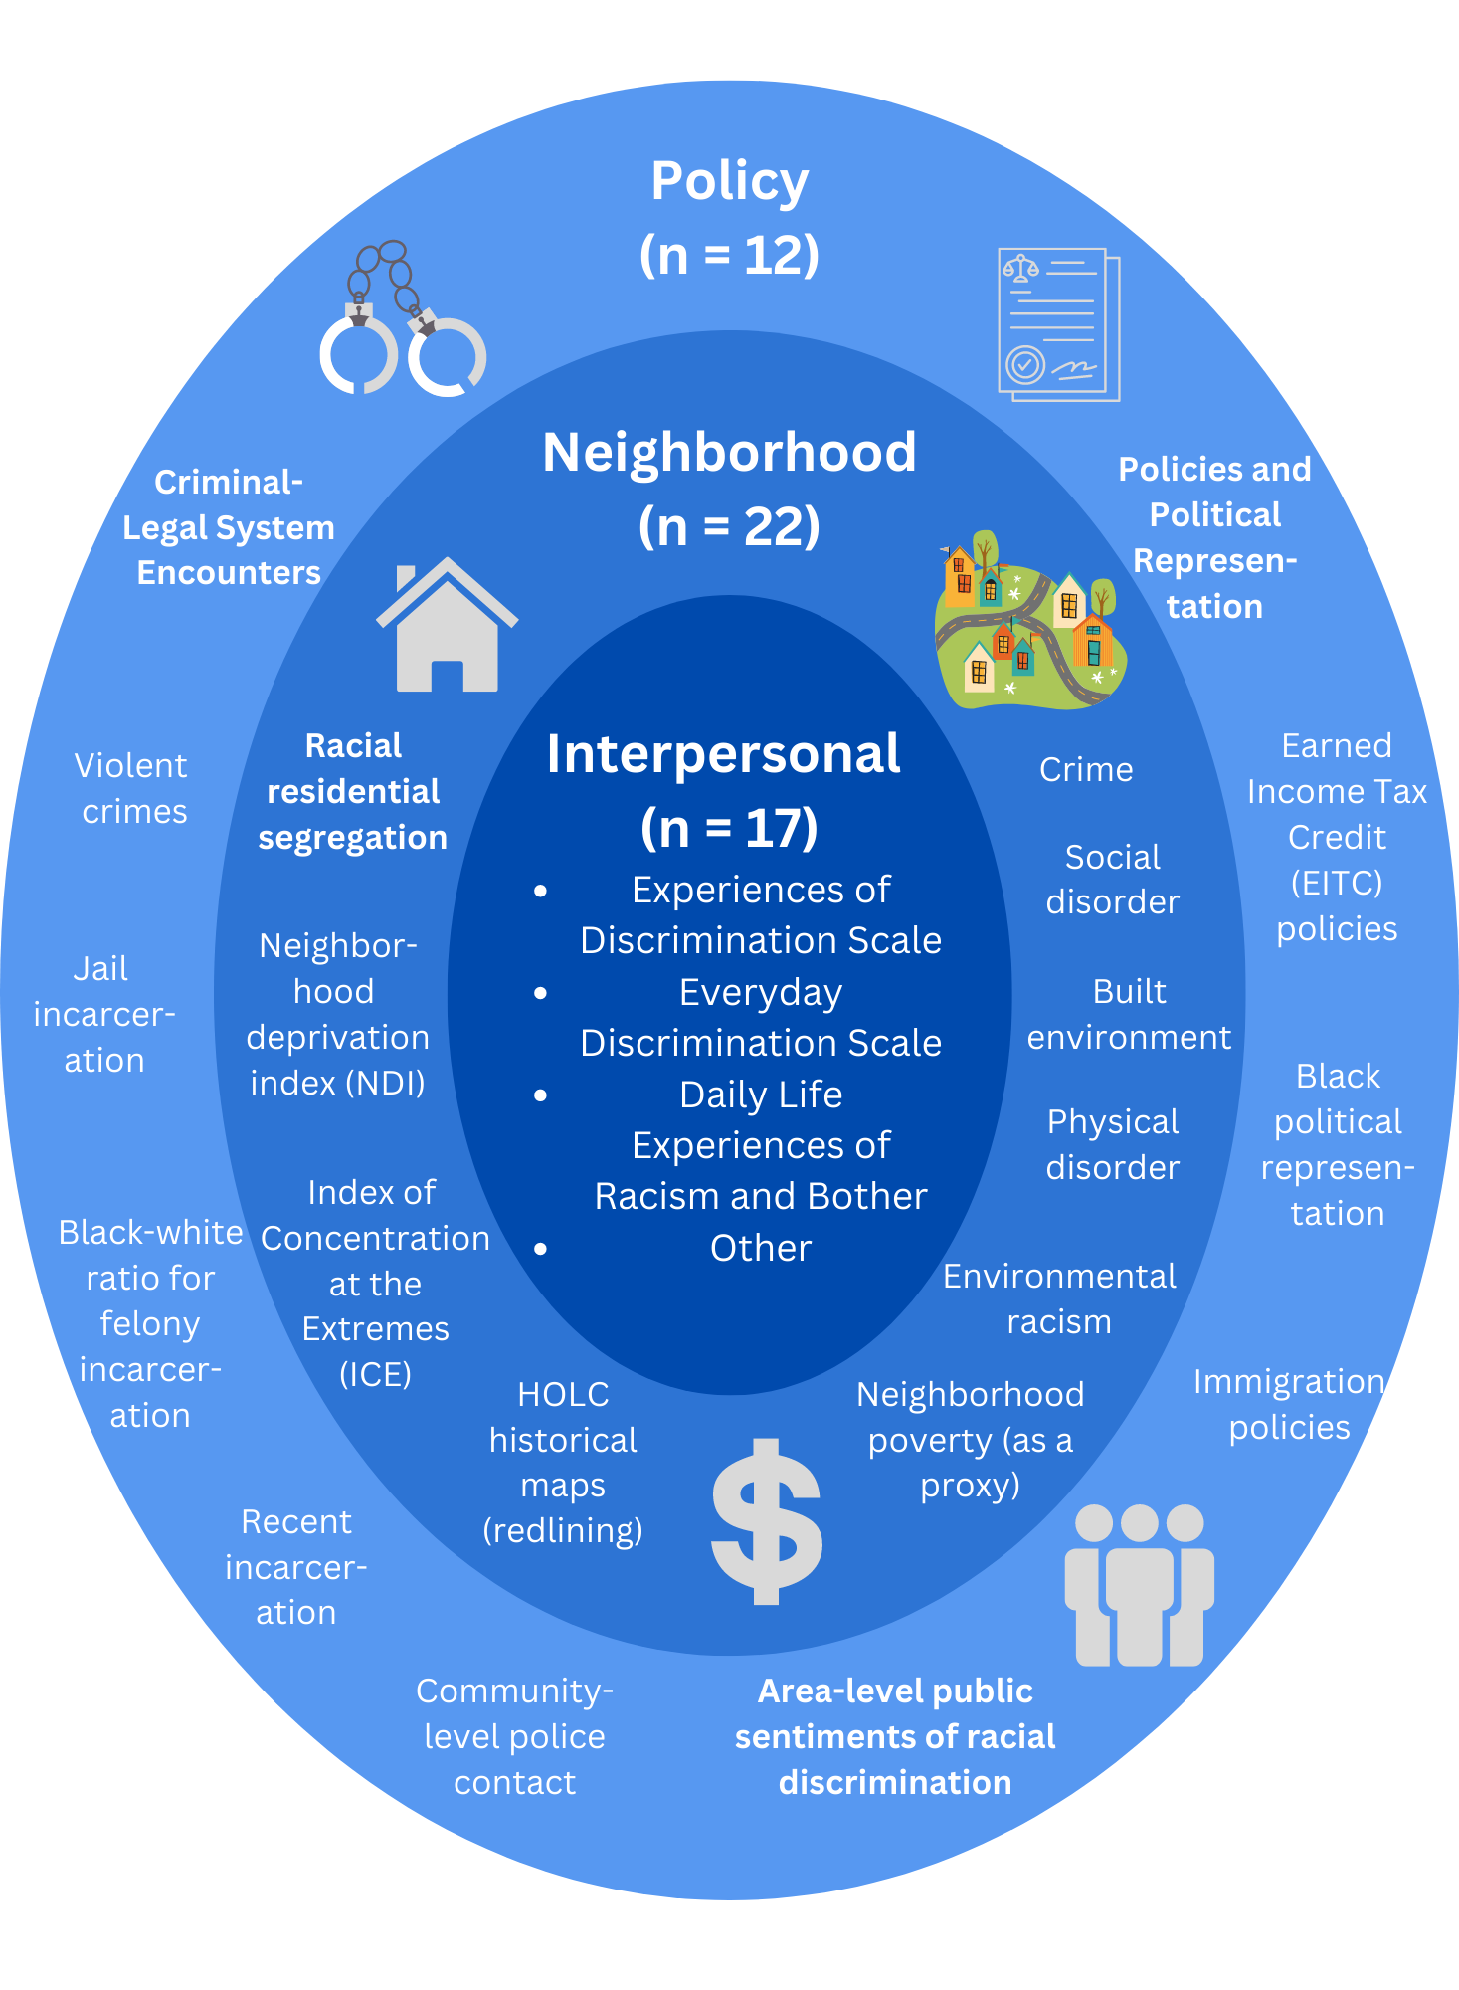
PREBIC Global Epidemiology and Health Disparities working group previously identified metrics of racism in preterm birth studies
Obstetrics & Gynecology 2022 In Press

Slide 3
Topics for PREBIC NA Branch Meeting
How can we integrate biological data in studies that measure health disparities (racism, inequities, social determinants, etc.)?
How do we standardize measurement of health disparities and inequities in preterm birth studies?
How can we determine the best analytic approaches to incorporate social determinants in preterm birth research?
  How can be better utilize electronic health record data?

Slide 4
PROBLEMS
GOALS
INPUTS
INPUTS 2
ACTIVITIES
Robust measures of racism that associate with preterm birth need to be identified.
Social determinants of health are often excluded from biological studies of preterm birth
Biological mechanisms directly influenced by racism that result in preterm birth have not been identified
Goal 1: Identify the best metric(s) of racism that can be incorporated in studies of preterm birth
Previously identified potential metrics through narrative review
Multidisciplinary expertise including perinatal epidemiologist, biostatistics, chemical engineering, OB/GYN clinician, demography, basic scientist, social scientist, population geneticist
Access to existing diverse biological cohorts
Educationally diverse
Track record of funding in the field
Tech time
Investigator time
Identify funding
Ad hoc grants BWF
Larger grant BWF
NIH grant
MOD
RWJ
Collaborations for data, etc.
Meta-analysis of existing metrics to identify those that best associate with preterm birth
Proof of concept study. Apply best metric(s) of racism, or a proxy, to a training dataset with biological data
Identify biological pathways that associated with best metric(s) of racism in a wide range of disease states
Design a prospective study to integrate racism metric(s) with biological variables to determine risk of preterm birth
Goal 2: Proof of concept: Test the best metric(s) of racism in an existing cohort with biological data.
Goal 3 Examine the metric in other disease processes to identify biological correlates.
Goal 4: Prospective study integrating racism metric(s) with biological variables
SHORT-TERM OUTCOMES
Specific Aims page for a proposal to submit for funding to Ad Hoc BWF
HYPOTHESIS
MEDIUM-TERM OUTCOMES
Epidemiologic risk factors and biological markers often do not explain the variability in risk of preterm birth.
We hypothesize that racism explains this variability.
Determine best metric and publish meta-analysis
Design proof of concept study and seek funding
Hypothesize biological pathways based on existing literature examining racism exposure and biological correlates
  Literature review of existing biological metrics
LONG-TERM OUTCOMES
Establish prospective cohort that integrates racism metrics with biological variables to determine risk for preterm birth

Slide 5
Paper 1: Meta-analysis of metrics of racism in preterm birth
The PREBIC Global Epidemiology and Health Disparities Working Group, previously conducted a systematic review of racism in preterm birth
The NA Branch Epidemiology and Heath Disparities Working Group will conduct a meta-analysis to identify how the metrics of racism previously identified are associated with preterm birth

Slide 6
Paper 2: Identify plausible biological pathways from racism to preterm birth
Literature search
  Expand beyond preterm birth and include any study that examined racism metrics and collected biological specimens
Racism Metrics
  NDI, ICE, Redlining
Specimen type
  Blood, serum, plasma, buffy coat, tissue, biopsy, saliva, urine, nail, stool, nasal swab, hair, placenta, amniotic fluid, cord blood, vaginal swab, cervical swab, cervicovaginal fluid, cerebrospinal fluid, breath analysis, bronchial lavage, sweat, phlegm, semen, interstitial fluid, umbilical cord,
Physiological markers
  Cardiac output, blood pressure, weight, body mass index, fat distribution, angiogram, MRI, functional MRI, CT, x-rays, respiratory rate, ultrasound,

Slide 7
Paper 3: Proof of Concept
Once racism metrics are identified and biological pathways identified, we will conduct a proof-of-concept study to show how racism explains more variability in preterm birth than race/ethnicity and biomarkers alone.

