Slide 1
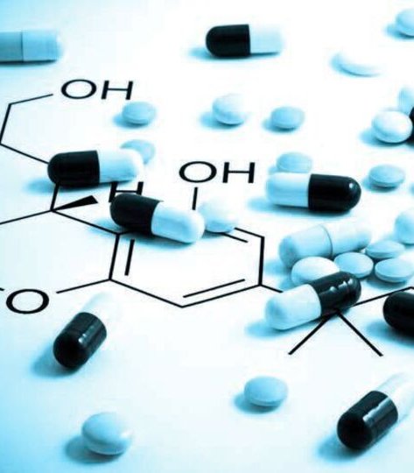
Incentivizing Pharmaceutical Companies to Invest in Preterm Birth
Working Group Members:
Sandra Reznick, Kristina Adams Waldorf, Angela Mosebarger, Gygeria (GG) Manuel,
Donna Russell, Chulhee Choi, Ananthkumar Kammala, Meredith Kelleher, Shajila Siricilla, Laura Goetzl, Kyungsun Choi, Amanda Wang, Benjamin Bush, Laura Goetzl, Mehmet Genc

Slide 2
The Problem
Drug pipeline for preterm birth is essentially non-existent
Insufficient incentives for pharmaceutical companies to invest in a preterm birth therapeutic
How can we incentivize the pipeline and offer new, creative strategies to jump start investment in research to reduce neonatal complications?

Slide 3
Manuscripts
Can preterm birth therapeutics be labeled as ‘orphan drugs’ in order to incentivize pharmaceutical companies? (manuscript nearly done – invited by AJOG)
Can we provide a roadmap for rapidly testing drugs in pregnancy that might prevent neonatal complications of prematurity?
--NEJM – Letter to the Editor, published following withdrawal of Makena? (Email sent to Michael Greene – Associate Editor), if unsuccessful….
--New submission to the American Association of Pharmaceutical Scientists Journal

Slide 4
Background and Rationale
Neonatal complications of prematurity often have an inflammatory components (bronchopulmonary dysplasia, periventricular leukomalacia, necrotizing enterocolitis, etc.)
Hundreds of anti-inflammatory therapeutics are FDA approved or in clinical trials
Some FDA therapeutics might be quickly pivoted to use in cases of early preterm labor to prevent neonatal complications
Framing of the focus of an FDA application and the pre-approval and confirmatory studies on a reduction in neonatal complications rather than a reduction in preterm birth might be advantageous

Slide 5
Elements of a Roadmap to Accelerate Drug Testing/Use in Pregnancy for Neonatal Benefit
What are the pros/cons of focusing drug development on prevention of neonatal complications of prematurity and away from preterm birth prevention?
How has this been done previously? Betamethasone for fetal lung maturation, magnesium sulfate for fetal neuroprotection, other drugs?
Which neonatal complications of prematurity might be the easiest to prevent with drug administration during pregnancy? Why?

Slide 6
Elements of a Roadmap to Accelerate Drug Testing/Use in Pregnancy for Neonatal Benefit
Which classes of therapeutics (anti-inflammatory?) might be the most successful in mitigating neonatal complications of prematurity? (placental drug transporters?)
If the drug is already FDA approved for another condition, what is the process to determine fetal safety in pregnancy?
Are there best practices for studies of therapeutics in pregnancy specifically for neonatal benefit?

Slide 7
PROS
CONS
PROPHYLACTIC: Women at risk for PTB | THERAPEUTIC: Targeting women in early PTL/ IUI inflammation
Larger market size (previous preterm labor or preterm baby, multiple gestations, shortened cervix ) | May improve rates of cerebral palsy, neonatal death, neonatal adverse outcome composite – very beneficial product for women's health
Prevention leads to better results (more ideals) | Shorter exposure to drug
Acceptance of a clinical trial to test a prophylactic likely high | Reduced medication cost because of shortened duration
May improve neonatal outcomes by reducing preterm birth, very beneficial for women's health
PROPHYLACTIC: Women at risk for PTB | THERAPEUTIC: Targeting women in early PTL/ IUI inflammation
Unnecessary treatment/ cost | Hard to identify/ inflammation (requires amniocentesis); field is reluctant to perform amnios
Low tolerance for adverse effects because it will be used prophylactically in healthy people (needs large margin of safety) | May impact fetal immune development as it is an immunomodulator
Longer exposure to drug | Smaller market size if on early PTB, may increase with chorioamnionitis / Term birth
Teratogenicity, may take place during embryogenesis | Controversial if fetus will benefit from treatment of intrauterine infection/inflammation; may have resistance to clinical trial
 | Likely to be given with antibiotics with potential for adverse effects (ORACLE II Trial)

Slide 8
Current Landscape of Prophylactics & Therapeutics
Pregnant women
at risk for preterm birth
Yes
No
Symptomatic
Cerclage
Steroids
Magnesium
Tocolysis - Indomethacin, Calcium channel blockers
Antibiotics
Delivery
Asymptomatic
Asymptomatic
Cerclage
Vaginal progesterone

Slide 9
Target Population – Patients per Year
Prophylaxis (at risk for PTB)
History (prior preterm birth)
  133,000
Short cervix (3%)
  109,929
Preterm birth biomarkers
  Target screen pos. rate = 20%
  Nulliparas = 245,650
  Multiparas w/history of prior PTB = 26,600 (if screen pos rate stays at 20%)
Treatment: early PTL +/- fever at term
Preterm birth < 34w = 2.75% of population = 100,768
Fever at term (conservative estimate based on fever rates at term by parity and type of analgesia) = 161,501

Slide 10
Drug Targets
Targeting Early PTL/IUI and Inflammation to Improve Neonatal Outcomes
Accelerating organ maturation,
Supporting normal development, reducing inflammation
Neonatal infection - antimicrobials
Inflammation in Neonate, AF, membrane
  NSAIDS, CSAIDS, Immune modulators, Cytokine/Chemokine blockers
Fetal brain
  Excitotoxicity, ROS/NO, Ion channel blockers, N/CSAIDS, Steroids, Antioxidants, Metabolic Failure/Mitochondria, maturation, White matter development (to prevent neurodevelopmental impairment)
Lung - surfactant, alveolar development, immune infiltrates, fibrosis (to prevent RDS, BPD, chronic lung disease)
Gut - maturation, villus development, inflammation, dysbiosis, antacids (to prevent NEC)
Neonatal Hemodynamics/Renal function (to target neonatal hypotension, hypoxic-ischemic organ injury)
Prophylactic Drug for Women
at Risk of Preterm Labor
Uterine quiescence
  ion channel blockers, PR, ER, H₂S, NSAIDS, PGs, NFKB, Thrombin, Smooth muscle Antagonists
Cervical competence
  P4, cerclage, injectable cerclage, cervical pessary
Target specificity (off-target effects) -- usually multiple targets
Does it cross the placenta? Advantage if doesn’t cross if prophylactic use
Does it cross the fetal BBB? Needed if targeting brain, not good if off-target
~ 500 words, 10 references

Slide 11
Maternal Outcomes
Neonatal Outcomes
Delivery <37 weeks gestation
Delivery before 35 weeks
Delivery before 32 weeks
Spontaneous abortion <20 weeks
Hospital visit for preterm labor/total length of hospital admission
Interval from intervention to delivery
Cost
Tocolytic therapy
Steroids for FLM
Cesarean delivery
Chorioamnionitis
PPROM
Admission to ICU
Any AEs specific to intervention
Fetal death/Stillbirth
Birth weight (<2500g)
Birth weight (<1500g)
Neonatal death
Transient tachypnea of the newborn
Respiratory distress syndrome
Bronchopulmonary dysplasia
Ventilatory support
Supplemental oxygen
Intraventricular hemorrhage – Grade 3 or 4
IVH - any grade
Necrotizing enterocolitis
Patent ductus arteriosus
Retinopathy
Proven sepsis
Hypotension requiring pressors
Neonatal composite outcomes
Neurodevelopmental assessments

Slide 12
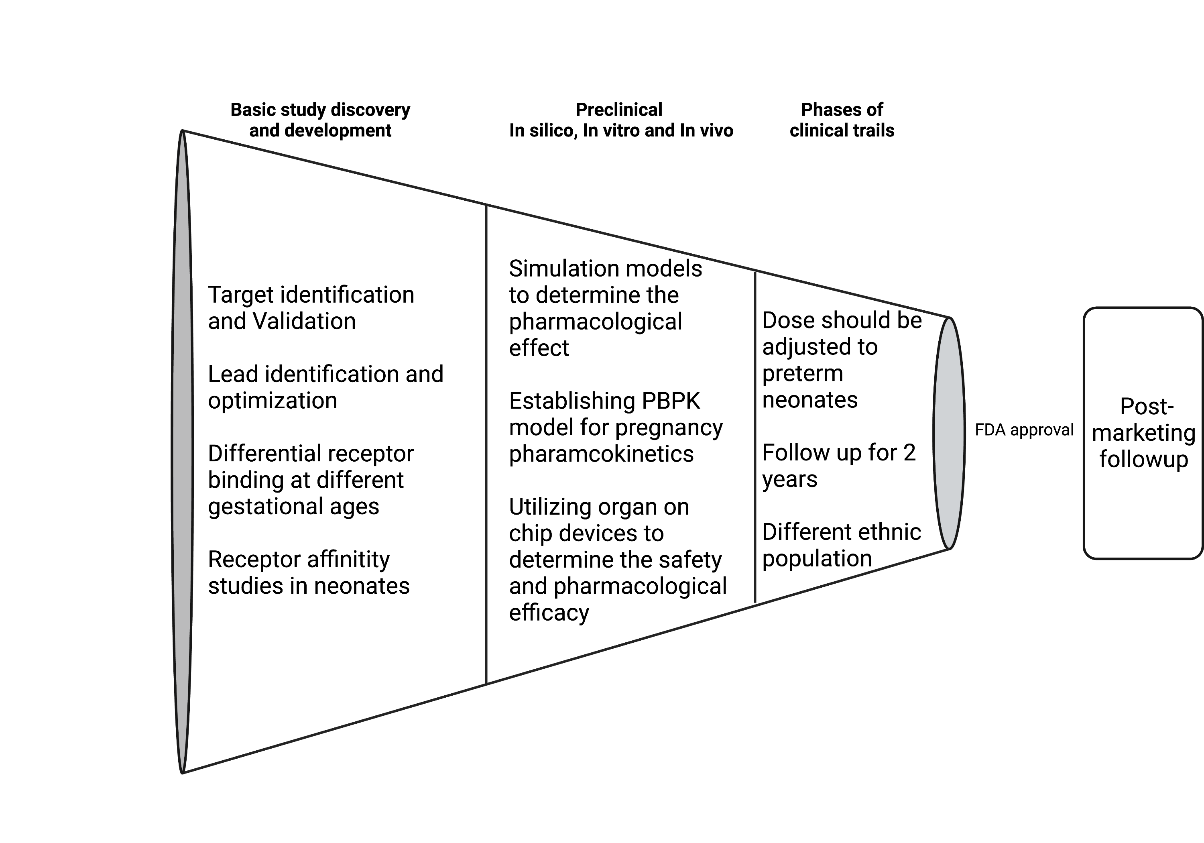
BEST PRACTICES
Phases of Clinical Trials

