Slide 1

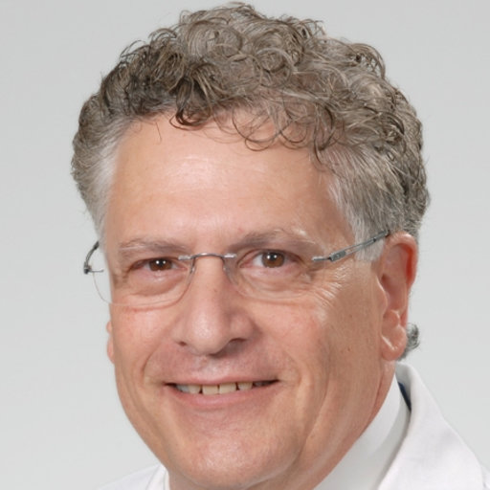
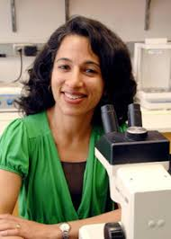
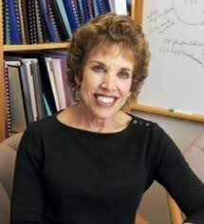

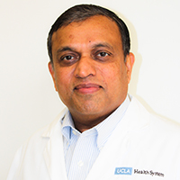

Theme: Translational Research - Conversation between Clinical and Basic Scientists
Group 4 !

Slide 2

Question 1:
What do we mean by translational research?
Research to clinic
When is basic research ready for translation?
Cell culture and lower/higher level animal model testing
Effective and safe
It would be nice to have established guidelines

Slide 3
Question 2:
How to approach design of basic experimental work that is ultimately translatable? What are the necessary factors?
Design a study that uses a cell culture or animal mode that is relevant to human biology
Treat or not treat with a drug of interest
Document mechanism of action
Collect data
→ Clinical trials

Slide 4
Question 2:
What are the barriers to doing this and how can they be overcome?
Obstacles
How to overcome them
  Animal models
  NIH does not require a translational section in grants
  Funding within Universities for MDs to conduct research
  The barrier between MDs (within departments) and PhDs
  → Use the right model to ask the right questions
  → promote this as a standard
  → advocate for time
  → Virtual groups – with incentives, meetings like PREBIC or within your own Universities

Slide 5


Question 3: How do we get the most out of clinical trials, so that the results can drive further basic experimentation?
Getting lost in translation
Basic science and clinical researchers should be involved in the design, follow up, and interpretation of clinical trials
  Quantity and type of sample collections → Guide costs
  sub-committees

Slide 6
Provide a platform where people can view potential clinical trials and prepare ancillary studies
  contributions between universities and between MDs and PhDs
Open access to data between networks that is easy to find and understand

Slide 7
Question 4:
How should the current grant review, funding, and regulatory framework for biomedical science be changed to support translational research in preterm birth?
It is common to provide “sex as a biological factor” sections in grants
Create a “translational relevance” section in grants
Evaluation of non-responding groups as a separate population

Slide 8
Funding ideas
TedTalks or pitches, maybe at SRI, where researchers and clinicians pitch their ideas to entrepreneurs, MDs with large clinical studies, venture capitalists, pharmaceutical companies, etc.
Create an angel group for prematurity → new funding source
Crowdsourcing
Advocate for political leverage on funding

