Slide 1
Group 2: Room 204
Jennifer Gudeman, PharmD; Cynthia Gyamfi-Bannerman, MD, MS; Narmada Lavu, MD; Thomas McElrath, MD, PhD; Sam Mesiano, PhD; Morgan Peltier, PhD; George Saade, MD; Brandy Taylor, PhD

Slide 2

Priorities: Sharing of Knowledge
Encourage sharing of knowledge and experience among trainees
  Fellows, faculty should spend time in the lab (already happening)
  Post docs should spend time in the clinic
    Immersion in clinic, more than one day, week v. months
    Understanding the phenotype, what are the conditions, how are they treated
    Answering clinically important questions
    Even time in the OR to learn anatomy
Encourage dialogue between the 2 sides

Slide 3
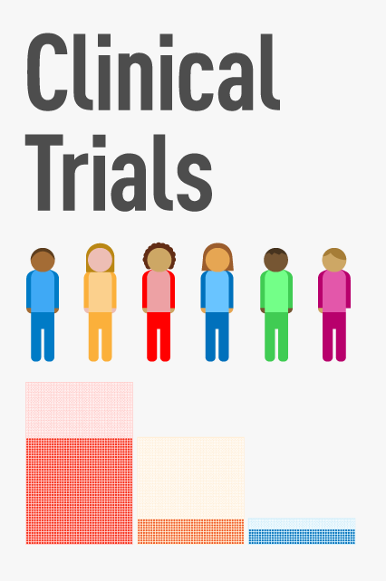
Priorities: Clinical Trials
Encouraging more clinical trials
Pilot studies
Encouraging basic science researchers to plan the path from experiment to clinical studies
  Understand the trajectory to clinical application

Slide 4

Priorities: Reconsidering Definitions
Definitions
  Figure out where they came from
Preterm is arbitrary
Preclampsia is not agreed upon by clinicians
  Initially defined as a screen for eclampsia
Cannot agree on phenotypes
What is clinically applicable and how can we get that information from basic science?
When do we deliver?
  Risk/benefits
  What is the ultimate goal, stopping labor or knowing which fetus will benefit from delivery

